Slide 1

WORKSHOP ON PYTHON & IMAGE PROCESSING
Dr. Akhilesh Das Gupta Institute of Technology and Management, New Delhi
Organized BY ECE Department
11th -12th February, 2020
Student Coordinators :
Zorawar Singh
Sumneet Kaur
Devjot Singh
Aman Puri
Pranav Gupta
HEAD OF DEPARTMENT: Prof. (Dr.) Rajiv Sharma
EVENT COORDINATOR:
Asstt. Prof. Swati

Slide 2
IMAGE PROCESSING
By Frizzy Pi

Slide 3
Image?
A 2D array of pixels
3 channels – (RGB/HSV)
Operations done Pixel by Pixel
For ease, we use UINT8 (?????)

Slide 4
Opening an Image
Cv2.imread(‘/path/file.ext’)
Cv2.imwrite(‘filename.ext’, image)
Cv2.imshow(‘message’, image)

Slide 5
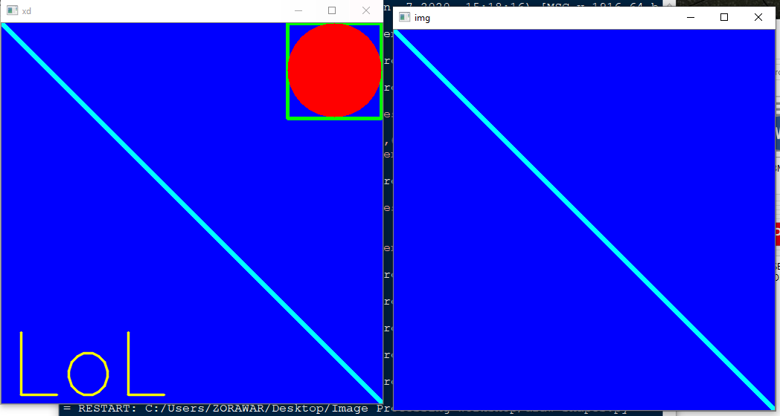
Shape/text/line draw

Slide 6
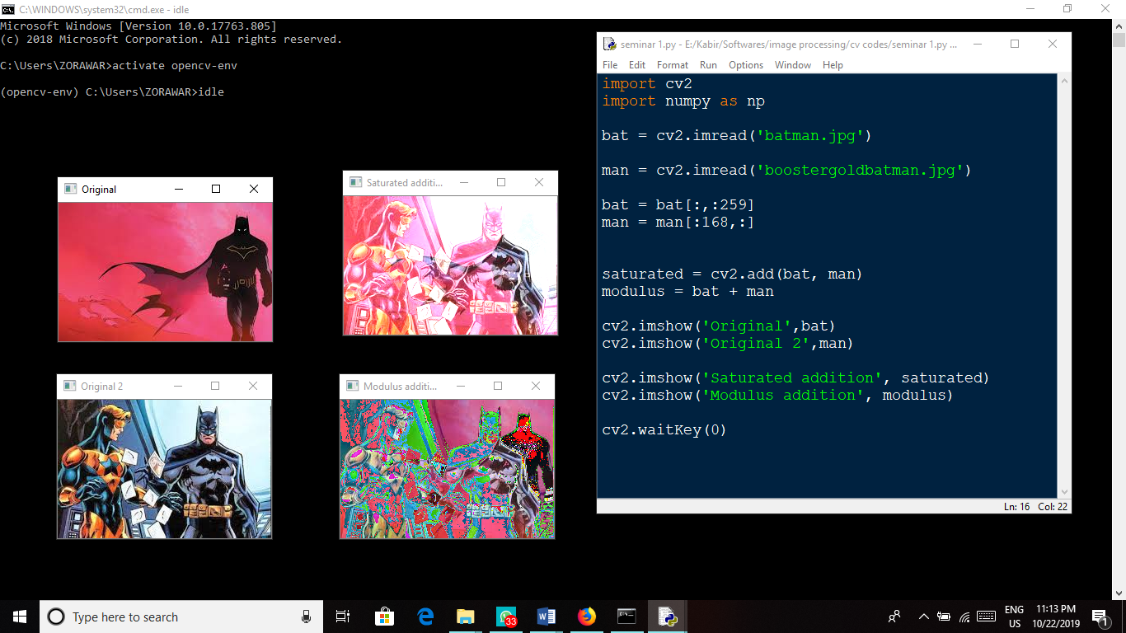
Addition of Images
Saturated
Modulus

Slide 7
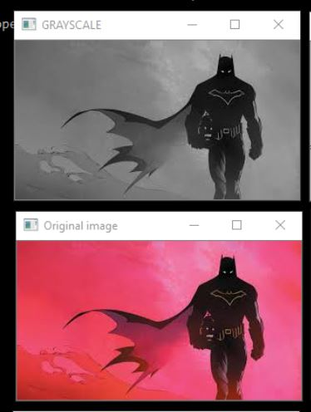
Image in Grayscale
Converts a 3 channel image to 1 channels.
Useful for Convolutions.
Reduces coloured noise.
Value lies between 0 and 255
Improves binary image
0 ➔ Black
255 ➔ White

Slide 8
Border?????
cv2.BORDER_CONSTANT - Adds a constant colored border.
The value should be given as next argument.
cv2.BORDER_REFLECT - Border will be mirror reflection
of the border elements, like this : fedcba|abcdefgh|hgfedcb
cv2.BORDER_REFLECT_101 or cv2.BORDER_DEFAULT –
Same as above, but with a slight change,
like this : gfedcb|abcdefgh|gfedcba
cv2.BORDER_REPLICATE - Last element is replicated throughout,
like this: aaaaaa|abcdefgh|hhhhhhh
cv2.BORDER_WRAP - Can’t explain,
it will look like this : cdefgh|abcdefgh|abcdefg

Slide 9
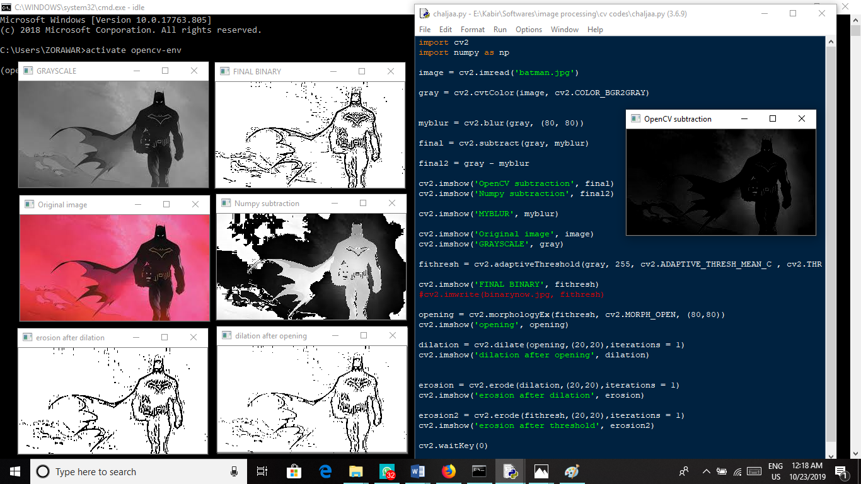
Morphological Operations

Slide 10
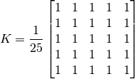
Convolution of an Image
Kernel ➔ A Kernel is a matrix (user defined) that operates on a Grayscale image.
The Kernel multiplies with the image and the sum of all the elements per iteration are added and denoted to the central pixel.
This helps in implementing LPFs (blurs)

Slide 11
Average Blur
Most basic
Takes average of pixels under kernel area
Also known as box blur

Slide 12
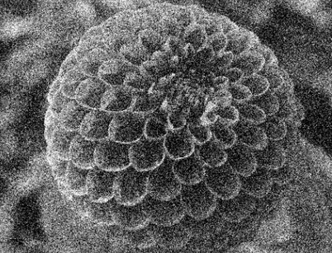
Gaussian Blur
Positive and odd h,w of kernel
Uses Gaussian Kernel
Standard deviation should be specified
Removes Gaussian noise

Slide 13
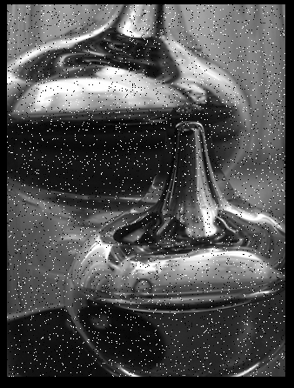
Median Blur
Retains edges
Removes Salt and Pepper Noise
Positive, odd h,w of kernel

Slide 14
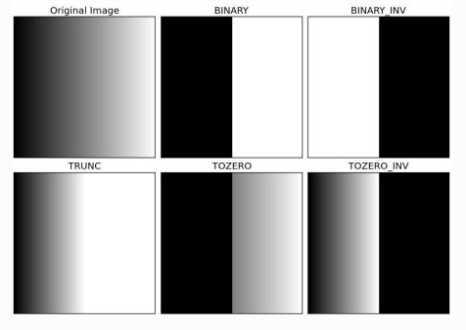
Thresholding

Slide 15
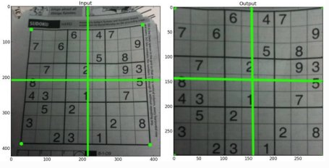
Transformation
AFFINE -----→ 3 POINTS
PERSPECTIVE ---→ 4 POINTS

Slide 16
Edge Detection
https://www.youtube.com/watch?v=XuD4C8vJzEQ
On the basis of the Principle of Convolution, we can find out the Vertical edges. Horizontal edges are found in a similar manner.

Slide 17
Canny Edge Detection
Noise Reduction
Intensity Gradient is found
Non Maximum Suppression
Hysteresis Suppression
ASSUMPTION – Edges are long lines

Slide 18
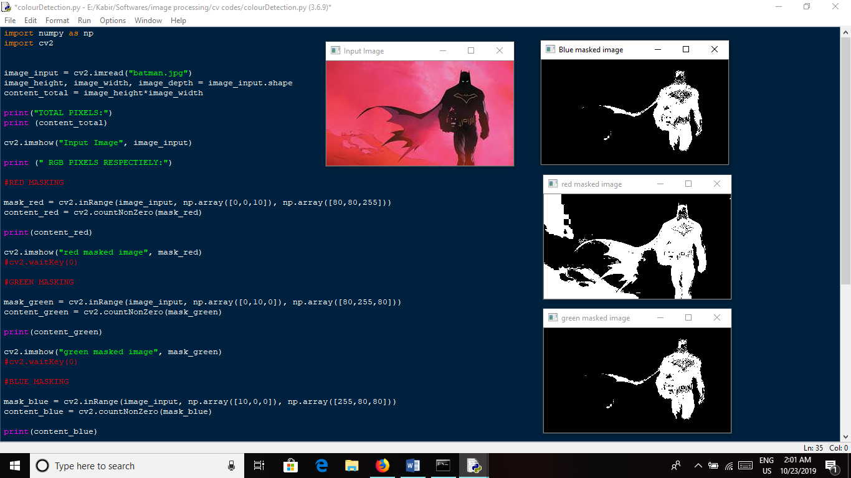
Masking of Image

Slide 19
Future Scope + More
Feature extraction
Haarcascading
Real Time Detection
Neural Network implementation
Pixel Binding
Security systems (Face Recognition, fingerprint recognition)

